Slide 1
PSTN: An Introduction
Notes:
Let’s start with PSTN Introduction..By the way PSTN stands for Public switch telephone network

Slide 2
Objectives
At the end of this session, you will be able to:
  Explain telecom evolution and typical milestones in telecom evaluation
  Understand typical composition of PSTN network and its topology
  Understand PSTN access network composition
  Understand basic terminologies used in PSTN network such as local loop, signaling, trunk, central office, etc.
  Understand typical scheme of PSTN addressing
  Understand signaling classification
CONFIDENTIAL© Copyright 2008 Tech Mahindra Limited

Slide 3
Agenda
Telecom Evolution
PSTN: Nuts and Bolts
PSTN: Typical Network Composition
Addressing and Routing
LATA, LEX and IXC
Introduction to signaling
CONFIDENTIAL© Copyright 2008 Tech Mahindra Limited

Slide 4





Telecommunication Evolution
Communication
Mail, etc.
Telecommunication
Telephony
Fax
Videoconference
E-mail
File Transfer
CONFIDENTIAL© Copyright 2008 Tech Mahindra Limited
Notes:
Telecommunication evolution
Meaning of Tele happens to be far , so it is far or distance communication…
Again in the today’s context there is no really no meaning for word ‘FAR’ goes. Nevertheless, I will not be surprised if communication crosses galaxies and planets in the days to come…we may find an address of website like … www.google.nr.milkiway
Shown in front are some modes of communication like Telephony, fax, video conference , email etc….
Of left side we have a typical Postal mail service …
Let’s move on further…

Slide 5
History of Telecom: An Overview
1837: Samuel Morse invents the telegraph
1858: Transoceanic telegraph cable was laid
1876: Alexander Graham Bell invents the
telephone
1877: Bell Telephone company was formed
1885: Incorporation of AT&T
1892: Invention of Strowger exchange
1912: Invention of initial crossbar exchange
1971: First electronic exchange, Fax
1976:Common Channel Signaling Introduced in Telecom Network
1980:Computer Telephony Introduced
1990:
  Digital telephony (SW/Transmission/Signaling), Video Conferencing
  Cell Phone
  Radio Paging
2000: Digital End To End service, Digital Mobile, Messaging,
80 Service,Colour fax, Video Phone etc.
CONFIDENTIAL© Copyright 2008 Tech Mahindra Limited
Notes:
Here are typical milestones achieved in the area of communication..yearwise
1837: A major break throrugh …Samuel Morse invented telegraph…prior to that communication was in very very initial stage…In this mode of communication information or data was transferred as a morse code
Year 1858.. This is the year where first ever transoceanic telegraph cable was laid
Again a major break though in year 1876: Alexander Graham Bell invented telephone
Year 1877… Bell Telephone company was formed
1885… Incorporation of AT&T
Again a very major breakthrough in 1892…Invention of Strowger exchange Because prior to that what we had was a manual exchange but credit goes to this gentleman called Strowzer who have replaced human intervention and invented first ever automatic exchange that is why the name Strowzer exchange
Year 1912: Limitations of Strowzer exchange lead to an Invention of initial crossbar exchange
And finally year 1971 where First electronic exchange was developed….

Slide 6
PSTN Characteristics
Public Switched Telephone Network
  Consists of transmission paths and nodes
  Based on star or mesh topologies, but made hierarchical across countries.
  Originally designed to carry voice but being used to carry data also
  Analog access , 300 Hz to 3400 Hz from Subscriber end, digital bandwidth 64 Kbps from exchange side (Extended to subscriber in ISDN).
  Circuit switched duplex connection
CONFIDENTIAL© Copyright 2008 Tech Mahindra Limited
Notes:
Let’s have a look at more details and the characteristics of PSTN
PSTN – Public Switch Telephone Network
PSTN consists of transmission paths and nodes
It is based on star or mesh topologies. By the way, topology is nothing but physical layout of the network. Telephones are connected to local exchange in a star topology and exchanges are connected with each other in a hierarchical mesh to have a better redundancy.
Let’s move onto next point. It was originally designed to carry voice but as you know ….now a days even data also is carried through telephony network. Of course the data rate is low.
It was meant for an Analog access , in the frequency range of 300 Hz to 3400 Hz. It happens to be a human voice range. By the way, it is worth to mention here that – human being can speak in the frequency range of 300 Hz to 3400 Hz but human can listen till 20Khz. Beyond 20Khz, human ear is going to act as a filer and it will never let above frequencies go inside. Digital bandwidth of voice communication comes out to be 64 Kbps. And we will soon see as to how this figure of 64Kbps is derived.
PSTN is Circuit switched duplex connection. The meaning of circuit switching is , end to end connection or so called circuit is fist established prior to communication and the meaning of duplex connection is two way data transfer can happen. Rather PSTN is full duplex in a sense voice communication can happen both way simultaneously also.

Slide 7
Transmission Techniques
Simplex
  In only one direction from transmitter to receiver.
  Example: radio,TV, Paging
Half-Duplex
  Two-way communications but in only one direction at a time.
  Example: walkie-talkie/Police wireless
Full-Duplex
  Simultaneous two-way communications
  Example: PSTN, Videoconferencing, Mobile cellular
CONFIDENTIAL© Copyright 2008 Tech Mahindra Limited
Notes:
Let’s try n understand different transmission techniques…
Simplex Communication: here direction of communication is only one way i.e. from transmitter to receiver. And the examples of simplex communication are : Radio , TV, Keyboard and display. For example, we can only take input from a keyboard, we can not output to a keyboard. Similarly we can only output to a console or a display device and the radio and TV transmission are the systems where we have radio transmitter or a TV transmitter which will transmit the signal and what we have , at our homes or business houses , are radio or TV receivers. And that is precisely we call radio and TV as a receiver.
Let’s go to next technique.
Half duplex communication …In this category, communication can happen in both the directions but not simultaneously…Example is walkie-talkie
On the contrary , Full-Duplex communication happens in both directions simultaneously. This is a difference between a half duplex and full duplex communication. Examples of full duplex communication are videoconferencing , telephony , computer network. In telephony both party can talk simultaneously…it is a different story that we as a human being never do so because communication path being used is same and the kios may occur so we follow a half duplex communication

Slide 8

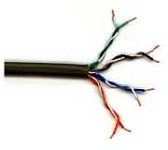

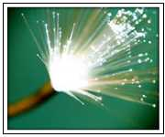
PSTN – Nuts and Bolts
CPE: Customer Premises Equipment (telephone & interfaces)
Transmission Medium
Switching Nodes
  Switching nodes which will establish a communication between end subscribers on demand
Signaling Systems
twisted pair
coax cable
optical transmission
1 Mm
300 Hz
10 km
30 kHz
100 m
3 MHz
1 m
300 MHz
10 mm
30 GHz
100 μm
3 THz
1 μm
300 THz
VLF
LF
MF
HF
VHF
UHF
SHF
EHF
infrared
visible light
UV
CONFIDENTIAL© Copyright 2008 Tech Mahindra Limited
Notes:
Here are nuts and bolts of PSTN. A composition of PSTN…
Customer Premises Equipment , Transmission medium and the switching nodes…
Let’s begin with CPE…As the name indicates it is the equipment that is installed by the service provider on a request by a customer at the customer premises.
Next thing is the transmission medium…
=============================
PSTN network is composed of CPE Customer Premise Equipment so called telephone, switching nodes or exchanges and transmission media to interconnection exchanges.
Communication media can be classified as wireline and wireless. Under wireline category , we have copper wire which comes in two forms – co-axial cable used for cabel TV and CN and twisted pair used for CN , Telephony. On the other hand we have fiber cable which can be throught of FAT wire. Fat in terms of bandwidth and amount information carrying capacity. By the way , nature of signal gets transmitted through fiber is light.
Under wireless category we have AIR. Electromagnetic waves of different frequency ranging from low to very high traverse through air. Even though AIR through with EM waves are transmitted is free and non propriatary , the freq. bands are licensed.
.
VLF = Very Low Frequency LF = Low Frequency (Submarine) MF = Medium Frequency (AM)
HF = High Frequency (AM) VHF = Very High Frequency (TV, Mobile)
UHF = Ultra High Frequency (TV, Mobile) SHF = Super High Frequency (Satellite)
EHF = Extra High Frequency(Satellite) OPTICAL = Optical Fiber links (IR)
UV = Ultraviolet Light
Nodes : Switches has gone a revolution starting from Manual switching, mechanical switching , electromechanical switching to today’s automatic switching
Types :
Local switch
Transit switch
International switch

Slide 9
Telephone Network at an Abstract Level
Core Network: Combination of switching centers and transmission systems connecting switching centers.
CORE
ACCESS
Access Networks: The portion of public switched network that connects access node (edge of access n/w) to the individual subscriber
CONFIDENTIAL© Copyright 2008 Tech Mahindra Limited
Notes:
PSTN is a combination of core network and access networks.
Core Network:
Combination of switching centers and transmission systems connecting switching centers. Switches are arranged in hierarchical meshy way. Transmission medium used in Fiber optic or air to send micro waves.
Access Network is the portion of public switched network that connects access node (edge of access n/w) to the individual subscriber
Access network in world is predominantly twisted copper wire connected to Analog telephone.

Slide 10


Access Network: Wireline Local Loop
Pillar
MDF
Local
Exchange
Distribution Point
Wall Socket
Distribution Point
Wall Socket
CONFIDENTIAL© Copyright 2008 Tech Mahindra Limited
Notes:
This is how a typical access network composition will look like. What you see over here is a wireline access network. Here every where in the access network there is wire. By the way in case of PSTN, access network uses twisted pair wire.
Let’s begin a journey from Customer premises equipment or so called telephone. Telephone of connected to wall socket. Wall socket is connection to distribution point which is typically a red box or a blue box. It is basically a passive concentration point. From Distribution point connections are brought onto a pillar and from Pillar multiple such connections are brought and terminated at MDF situated in the local exchange. By the MDF stands for Main Distribution Frame. Behind MDF, there is LIC card which will take care of A-2-D and D-2-A conversion i.e. analog to digital and digital to analog conversion in case of digital exchange.
=======
Let’s have a look some terminology with reference to access network.
Local Loop :
The local loop is the telephone line that runs from the telephone company’s local exchange to your home or business. It is also called as Subscriber local loop or In the US Telecom scenario it called as “Last Mile”. It starts with Telephone at the subscribers end which is connected to wall socket, which in turn are connected to distribution point were all line are from the wall sockets in localized area are collected . DPs are connected to Pillar which a concentration point for DPs and finally all lines from Piller are terminated at MDF i.e. Main Distribution Frame at local exchange. Transmission of voice from telephone to exchange is analog in nature. It is interesting to note that power for telephone is provided by an exchange.

Slide 11



Access Network: Wireless [WILL]
Radio is sometimes cheaper than digging the streets!
Where wire can not reach
CONFIDENTIAL© Copyright 2008 Tech Mahindra Limited
Notes:
…this is especially a solution …. Where wire can not reach for whet ever reason and exchange has facility

Slide 12
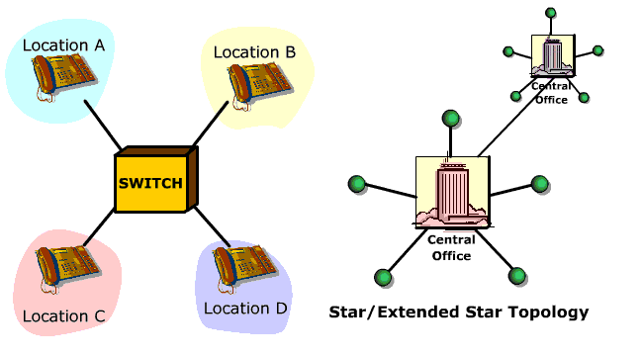
Topology - Star
CONFIDENTIAL© Copyright 2008 Tech Mahindra Limited

Slide 13
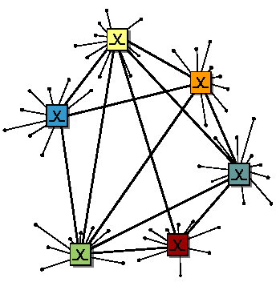
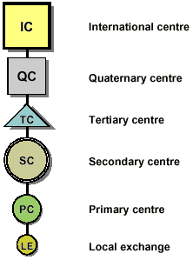
Telephone Network Topology
Mesh-shaped network with
direct connections between every node
The network hierarchy according to the ITU-T
CONFIDENTIAL© Copyright 2008 Tech Mahindra Limited
Notes:
Slide added for clarity. It is repeated else where also.

Slide 14
Introduction - Telephone Systems
Local Loop
  The pair of wires that runs from the Telephone Exchange into our home or business office
Phone Line
  Communication path between CO(central office) and our home
  Twisted pair 22 AWG or 0.5 mm copper wires
Line Circuit
  The voltage applied to the line to drive the telephone is -48 Volts DC
Central Office
  is the hub of a city’s telephone network, providing power for the telephones, routing the calls ,and recording the necessary billing information. Also known as Telephone Exchange
Trunk communication path between CO’s
Switch a device that routes communications to different parties
CONFIDENTIAL© Copyright 2008 Tech Mahindra Limited

Slide 15

TELCO Network – An Architecture
4776970
6234567
`
LEC
RE
`
CO
LEC
LEC
CO
CO
6736476
LEC
LEC
LEC
6292905
6433180
CONFIDENTIAL© Copyright 2008 Tech Mahindra Limited
Notes:
Local Loop
the pair of wires that runs from the Telephone Exchange into our home or business office connecting to CPE.
Local Exchange
is the hub for location’s telephone network
Central Office
is the hub of a city’s telephone network, providing power for the telephones, routing the calls ,and recording the necessary billing information. Also known as Telephone Exchange. If you place a long distance call, the central office passes your telephone call off to a long distance provider.
Trunk
A trunk is a special telephone line that runs between central offices and other telephone company switching centers.
A trunk is usually digital, high speed, and carries multiple telephone circuits.
Switch
a device that routes communications to different parties.
LATA (Local Access Transport Area ) Again in US context the area being server by local exchange is called LATA.
The USA is divided into a few hundred local access transport areas (LATAs).
LEC ( Local Exchange Carrier )
Telco operator who offers services in LATA are called Local exchange carrier. If your call stays within a LATA, it is a local distance call and is handled by a local telephone company called LEC.
IXC ( Inter Exchange Carrier )
If your call goes from one LATA to another and happens to be a long distance call and is handled by a long distance telephone company called Inter exchange carrier. MCI , Sprint , AT&T are dominant players in IXC area.
A telephone number is an unique identification of subscriber in the world. To uniquely identify one subscriber , telephone number consists of Country code , city/area code, an exchange code and a subscriber number.

Slide 16
Addressing and Routing
Each subscriber has address (telephone number)
  Hierarchical addresses
Telephone address used for setting up route from caller to callee
091
020
253
66689
country
code
City/area
code
number of
local
exchange
subscriber
number
CONFIDENTIAL© Copyright 2008 Tech Mahindra Limited

Slide 17
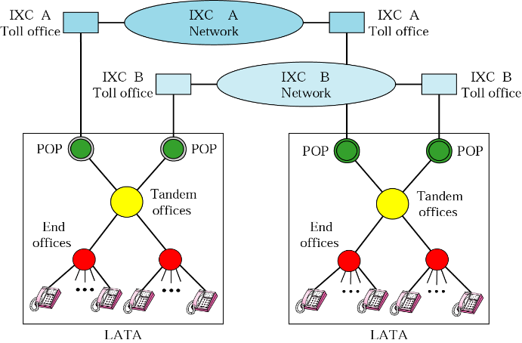
LATA, LEC and IXC
CONFIDENTIAL© Copyright 2008 Tech Mahindra Limited
Notes:
LATA …Local Access Transport Area
LEC : Local Exchange Carrier
IXC : Interexchange Carrier
POP: Point of Presence

Slide 18
Introduction - Voice Signaling
Signal Name
  Off-hook
  Dial tone
  Address
  Ring tone
  Busy Signal
  On-hook
  Supervision
Function
  Informs CO that user want to call
  Informs user to Dial numbers
  User Dials Number
  Informs user that destination phone is ringing
  Informs the user that destination phone is in use
  Informs CO that user has disconnected
  Supervises the condition of subscriber state
CONFIDENTIAL© Copyright 2008 Tech Mahindra Limited

Slide 19
Summary
In this session, we have learned:
  Telecom evolution along with typical milestones achieved in the journey of telecom so far
  Typical composition of PSTN network and its topology
  PSTN access network components: Wireline access network and wireless access network
  PSTN terminologies: local loop, signaling , trunk, Central office, LATA, LEC, IXC
  Telephone addressing and routing scheme
  PSTN signaling classification
CONFIDENTIAL© Copyright 2008 Tech Mahindra Limited

Slide 20
Thank You

